Slide 1
Segmentation
Steps:
Go to slide 2
Select slide show option
Click on Replay

Slide 2

Segmentation
Memory-management scheme that supports user view of memory
A program is a collection of segments
A segment is a logical unit such as:
main program
procedure
function
method
object
local variables, global variables
common block
stack
symbol table
arrays

Slide 3
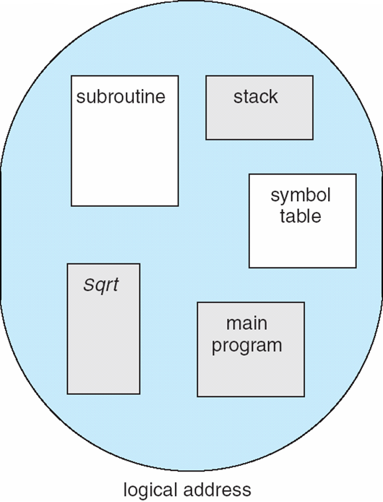
User’s View of a Program

Slide 4
Logical View of Segmentation
1
1
4
2
3
4
2
3
user space
physical memory space

Slide 5
Segmentation Architecture
Logical address consists of a two tuple:
<segment-number, offset>,
Segment table – maps two-dimensional physical addresses; each table entry has:
base – contains the starting physical address where the segments reside in memory
limit – specifies the length of the segment
The segment table is thus essentially an array of base-limit register pairs.
Segment-table base register (STBR)
Segment-table length register (STLR)

Slide 6
Segmentation Architecture (Cont.)
Protection
With each entry in segment table associate:
validation bit = 0 ⇒ illegal segment
read/write/execute privileges
Protection bits associated with segments; code sharing occurs at segment level

Slide 7
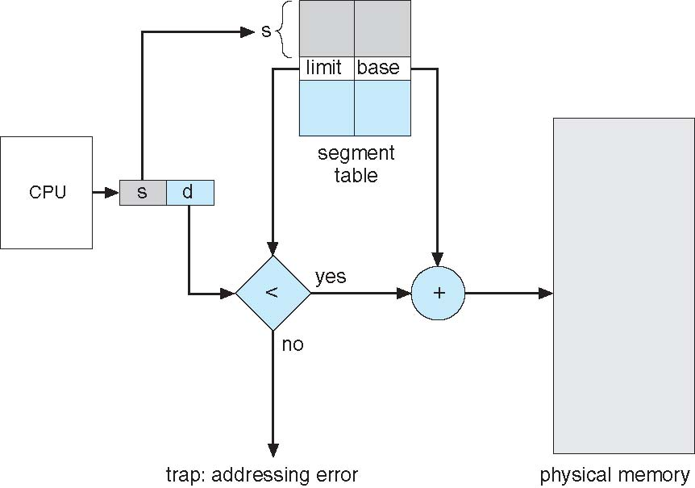
Segmentation Hardware

Slide 8
Consider the following segment table:
Segment Base Length
0 219 600
1 2300 14
2 90 100
3 1327 580
4 1952 96
What are the physical addresses for the following logical addresses?
[s, d]
a. 0, 430
430<600
PA= Base + offset= 219+430=649
b. 2, 500
500>100, illegal reference, traps

Slide 9
Homework
What are the physical addresses for the following logical addresses?
a. 1, 10
b. 3, 400
c. 4, 112

